Slide 1
Chapter 18
Testing Conventional Applications
Slide Set to accompany
Software Engineering: A Practitioner’s Approach, 7/e
by Roger S. Pressman
Slides copyright © 1996, 2001, 2005, 2009 by Roger S. Pressman
For non-profit educational use only
May be reproduced ONLY for student use at the university level when used in conjunction with Software Engineering: A Practitioner's Approach, 7/e. Any other reproduction or use is prohibited without the express written permission of the author.
All copyright information MUST appear if these slides are posted on a website for student use.
These slides are designed to accompany Software Engineering: A Practitioner’s Approach, 7/e (McGraw-Hill 2009). Slides copyright 2009 by Roger Pressman.

Slide 2
Testability
Operability—it operates cleanly
Observability—the results of each test case are readily observed
Controllability—the degree to which testing can be automated and optimized
Decomposability—testing can be targeted
Simplicity—reduce complex architecture and logic to simplify tests
Stability—few changes are requested during testing
Understandability—of the design
These slides are designed to accompany Software Engineering: A Practitioner’s Approach, 7/e (McGraw-Hill 2009). Slides copyright 2009 by Roger Pressman.

Slide 3
What is a “Good” Test?
A good test has a high probability of finding an error
A good test is not redundant.
A good test should be “best of breed”
A good test should be neither too simple nor too complex
These slides are designed to accompany Software Engineering: A Practitioner’s Approach, 7/e (McGraw-Hill 2009). Slides copyright 2009 by Roger Pressman.

Slide 4
Internal and External Views
Any engineered product (and most other things) can be tested in one of two ways:
  Knowing the specified function that a product has been designed to perform, tests can be conducted that demonstrate each function is fully operational while at the same time searching for errors in each function;
  Knowing the internal workings of a product, tests can be conducted to ensure that "all gears mesh," that is, internal operations are performed according to specifications and all internal components have been adequately exercised.
These slides are designed to accompany Software Engineering: A Practitioner’s Approach, 7/e (McGraw-Hill 2009). Slides copyright 2009 by Roger Pressman.

Slide 5
Test Case Design
"Bugs lurk in corners
and congregate at
boundaries ..."
Boris Beizer
OBJECTIVE
to cover errors
CRITERIA
in a complete manner
CONSTRAINT
with a minimum of effort and time
These slides are designed to accompany Software Engineering: A Practitioner’s Approach, 7/e (McGraw-Hill 2009). Slides copyright 2009 by Roger Pressman.

Slide 6
Exhaustive Testing
loop < 20 X
14
There are 10 possible paths! If we execute one
test per millisecond, it would take 3,170 years to
test this program!!
These slides are designed to accompany Software Engineering: A Practitioner’s Approach, 7/e (McGraw-Hill 2009). Slides copyright 2009 by Roger Pressman.

Slide 7
Selective Testing
Selected path
loop < 20 X
These slides are designed to accompany Software Engineering: A Practitioner’s Approach, 7/e (McGraw-Hill 2009). Slides copyright 2009 by Roger Pressman.

Slide 8
Software Testing
white-box
methods
black-box
methods
Methods
Strategies
These slides are designed to accompany Software Engineering: A Practitioner’s Approach, 7/e (McGraw-Hill 2009). Slides copyright 2009 by Roger Pressman.

Slide 9

White-Box Testing
... our goal is to ensure that all
statements and conditions have
been executed at least once ...
These slides are designed to accompany Software Engineering: A Practitioner’s Approach, 7/e (McGraw-Hill 2009). Slides copyright 2009 by Roger Pressman.

Slide 10
Why Cover?
logic errors and incorrect assumptions
are inversely proportional to a path's
execution probability
we often
believe
that a path is not
likely to be executed; in fact, reality is
often counter intuitive
typographical errors are random; it's
likely that untested paths will contain
some
These slides are designed to accompany Software Engineering: A Practitioner’s Approach, 7/e (McGraw-Hill 2009). Slides copyright 2009 by Roger Pressman.

Slide 11
Basis Path Testing
First, we compute the cyclomatic
complexity:
number of simple decisions + 1
or
number of enclosed areas + 1
In this case, V(G) = 4
These slides are designed to accompany Software Engineering: A Practitioner’s Approach, 7/e (McGraw-Hill 2009). Slides copyright 2009 by Roger Pressman.

Slide 12
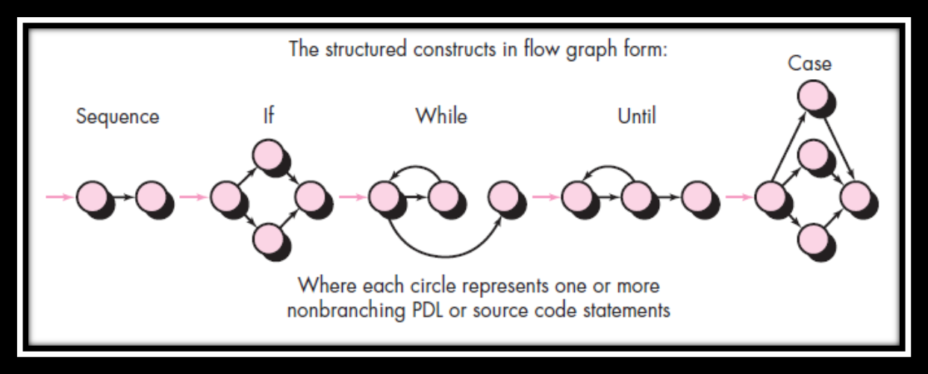
Basis Path Testing
These slides are designed to accompany Software Engineering: A Practitioner’s Approach, 7/e (McGraw-Hill 2009). Slides copyright 2009 by Roger Pressman.

Slide 13
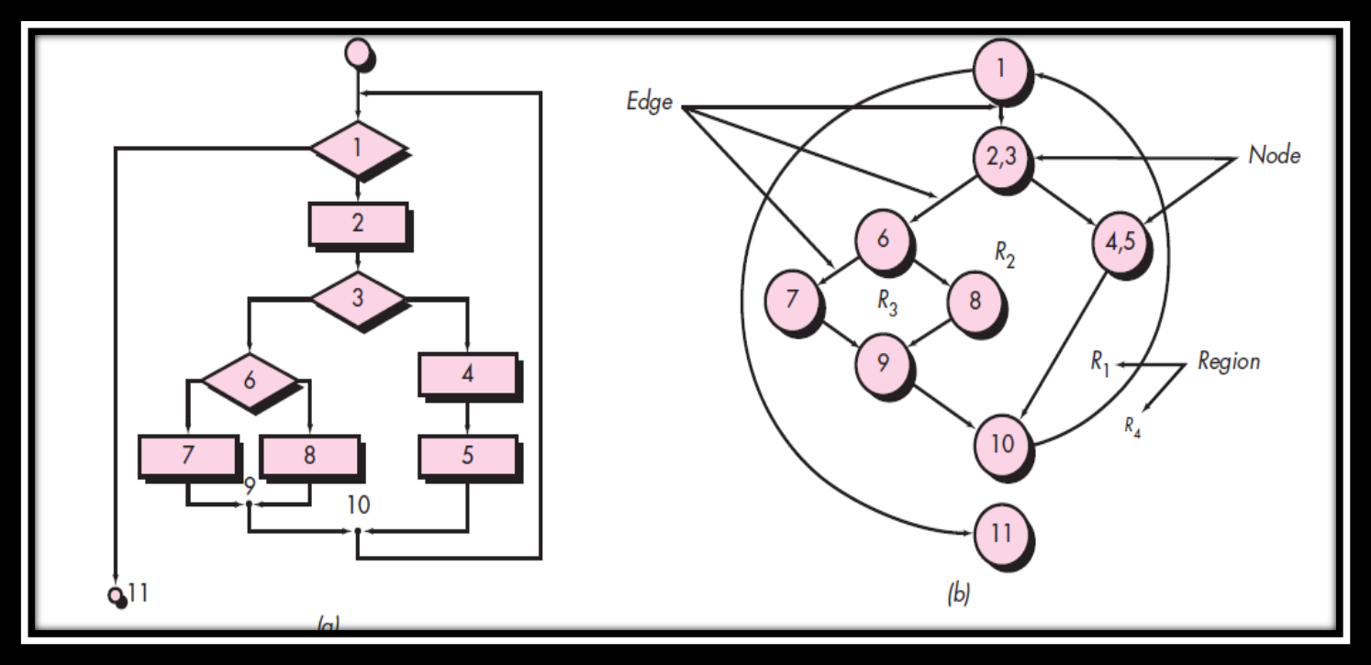
Basis Path Testing
These slides are designed to accompany Software Engineering: A Practitioner’s Approach, 7/e (McGraw-Hill 2009). Slides copyright 2009 by Roger Pressman.

Slide 14
Independent Program Path Testing
1
Next, we derive the
independent paths:
2
Since V(G) = 4,
there are four paths
3
Path 1: 1,2,3,6,7,8
4
Path 2: 1,2,3,5,7,8
5
6
Path 3: 1,2,4,7,8
Path 4: 1,2,4,7,2,4,...7,8
Finally, we derive test
7
cases to exercise these
paths.
8
These slides are designed to accompany Software Engineering: A Practitioner’s Approach, 7/e (McGraw-Hill 2009). Slides copyright 2009 by Roger Pressman.

Slide 15
Cyclomatic Complexity
A number of industry studies have indicated
that the higher V(G), the higher the probability
or errors.
modules
V(G)
modules in this range are
more error prone
These slides are designed to accompany Software Engineering: A Practitioner’s Approach, 7/e (McGraw-Hill 2009). Slides copyright 2009 by Roger Pressman.

Slide 16
Cyclomatic Complexity
Complexity is computed in one of three ways:
1. The number of regions of the flow graph corresponds to the cyclomatic complexity.
2. Cyclomatic complexity V(G) for a flow graph G is defined as V(G) = E - N + 2
where E is the number of flow graph edges and N is the number of flow graph nodes.
3. Cyclomatic complexity V(G) for a flow graph G is also defined as
V(G) = P + 1
where P is the number of predicate nodes contained in the flow graph G.

Slide 17
Cyclomatic Complexity
These slides are designed to accompany Software Engineering: A Practitioner’s Approach, 7/e (McGraw-Hill 2009). Slides copyright 2009 by Roger Pressman.

Slide 18
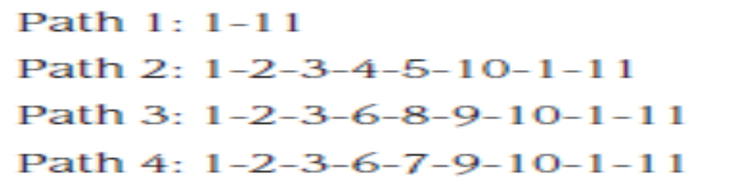
Cyclomatic Complexity
1. The flow graph has four regions.
2. V(G) = 11 edges - 9 nodes + 2 = 4.
3. V(G) = 3 predicate nodes + 1 = 4.
These slides are designed to accompany Software Engineering: A Practitioner’s Approach, 7/e (McGraw-Hill 2009). Slides copyright 2009 by Roger Pressman.

Slide 19
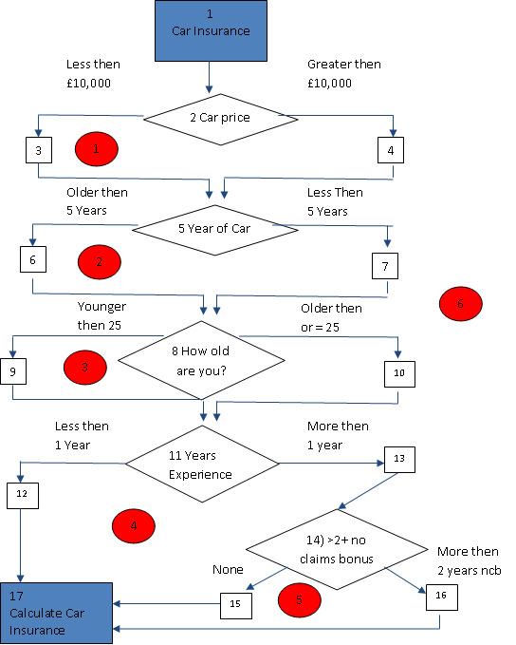
Line Coverage – Correctness Tests Cont.

Slide 20
Conclude McCabes Theory
The formulae:
V(G) = R
V (G) = E –N + 2
V(G) = P + 1
Our Example
V(G) = 6
V(G) = 21 -17 + 2 = 6
V(G) = 5 + 1 = 6
Resulting metrics calculations indicate that the maximum number of independent paths is 6.
Summary
Programs with cyclomatic complexities of less then 5 are simple and easy to understand
20+ The complexity is perceived as high.
50+ the software for practical purposes becomes unpractical.

Slide 21
Line Coverage – Correctness Tests Cont.
Complete Full Path Coverage
1= 1-2-3-5-6-8-9-11-12-17
2= 1-2-3-5-6-8-9-13-14-15-17
3= 1-2-3-5-6-8-9-11-13-14-16
4= 1-2-3-5-6-8-10-11-17
…
13= 1-2-4-5-6-8-9-11-12-17
14= 1-2-4-5-6-8-9-13-14-15-17
…
23= 1-2-4-5-7-8-10-11-13-14-15-17
24= 1-2-4-5-7-8-10-11-13-14-16-17

Slide 22
Deriving Test Cases
Summarizing:
  Using the design or code as a foundation, draw a corresponding flow graph.
  Determine the cyclomatic complexity of the resultant flow graph.
  Determine a basis set of linearly independent paths.
  Prepare test cases that will force execution of each path in the basis set.
These slides are designed to accompany Software Engineering: A Practitioner’s Approach, 7/e (McGraw-Hill 2009). Slides copyright 2009 by Roger Pressman.

Slide 23
Graph Matrices
A graph matrix is a square matrix whose size (i.e., number of rows and columns) is equal to the number of nodes on a flow graph
Each row and column corresponds to an identified node, and matrix entries correspond to connections (an edge) between nodes.
By adding a link weight to each matrix entry, the graph matrix can become a powerful tool for evaluating program control structure during testing
These slides are designed to accompany Software Engineering: A Practitioner’s Approach, 7/e (McGraw-Hill 2009). Slides copyright 2009 by Roger Pressman.

Slide 24
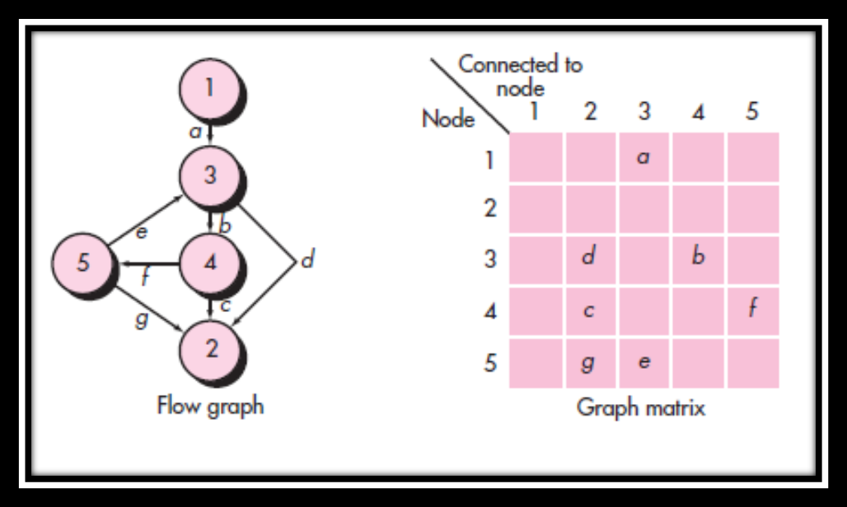
Graph Matrices
These slides are designed to accompany Software Engineering: A Practitioner’s Approach, 7/e (McGraw-Hill 2009). Slides copyright 2009 by Roger Pressman.

Slide 25
Control Structure Testing
Condition testing — a test case design method that exercises the logical conditions contained in a program module
Data flow testing — selects test paths of a program according to the locations of definitions and uses of variables in the program
These slides are designed to accompany Software Engineering: A Practitioner’s Approach, 7/e (McGraw-Hill 2009). Slides copyright 2009 by Roger Pressman.

Slide 26
Data Flow Testing
The data flow testing method [Fra93] selects test paths of a program according to the locations of definitions and uses of variables in the program.
  Assume that each statement in a program is assigned a unique statement number and that each function does not modify its parameters or global variables. For a statement with S as its statement number
    DEF(S) = {X | statement S contains a definition of X}
    USE(S) = {X | statement S contains a use of X}
  A definition-use (DU) chain of variable X is of the form [X, S, S'], where S and S' are statement numbers, X is in DEF(S) and USE(S'), and the definition of X in statement S is live at statement S'
These slides are designed to accompany Software Engineering: A Practitioner’s Approach, 7/e (McGraw-Hill 2009). Slides copyright 2009 by Roger Pressman.

Slide 27
Loop Testing
Simple
loop
Nested
Loops
Concatenated
Loops
Unstructured
These slides are designed to accompany Software Engineering: A Practitioner’s Approach, 7/e (McGraw-Hill 2009). Slides copyright 2009 by Roger Pressman.
Loops

Slide 28
Loop Testing: Simple Loops
Minimum conditions—Simple Loops
1. skip the loop entirely
2. only one pass through the loop
3. two passes through the loop
4. m passes through the loop m < n
5. (n-1), n, and (n+1) passes through
the loop
where n is the maximum number
of allowable passes
These slides are designed to accompany Software Engineering: A Practitioner’s Approach, 7/e (McGraw-Hill 2009). Slides copyright 2009 by Roger Pressman.

Slide 29
Loop Testing: Nested Loops
Nested Loops
Start at the innermost loop. Set all outer loops to their
minimum iteration parameter values.
Test the min+1, typical, max-1 and max for the
innermost loop, while holding the outer loops at their
minimum values.
Move out one loop and set it up as in step 2, holding all
other loops at typical values. Continue this step until
the outermost loop has been tested.
Concatenated Loops
If the loops are independent of one another
then treat each as a simple loop
else* treat as nested loops
endif*
for example, the final loop counter value of loop 1 is
used to initialize loop 2.
These slides are designed to accompany Software Engineering: A Practitioner’s Approach, 7/e (McGraw-Hill 2009). Slides copyright 2009 by Roger Pressman.

Slide 30
Black-Box Testing
requirements
output
input
events
These slides are designed to accompany Software Engineering: A Practitioner’s Approach, 7/e (McGraw-Hill 2009). Slides copyright 2009 by Roger Pressman.

Slide 31
Black-Box Testing
How is functional validity tested?
How is system behavior and performance tested?
What classes of input will make good test cases?
Is the system particularly sensitive to certain input values?
How are the boundaries of a data class isolated?
What data rates and data volume can the system tolerate?
What effect will specific combinations of data have on system operation?
These slides are designed to accompany Software Engineering: A Practitioner’s Approach, 7/e (McGraw-Hill 2009). Slides copyright 2009 by Roger Pressman.

Slide 32
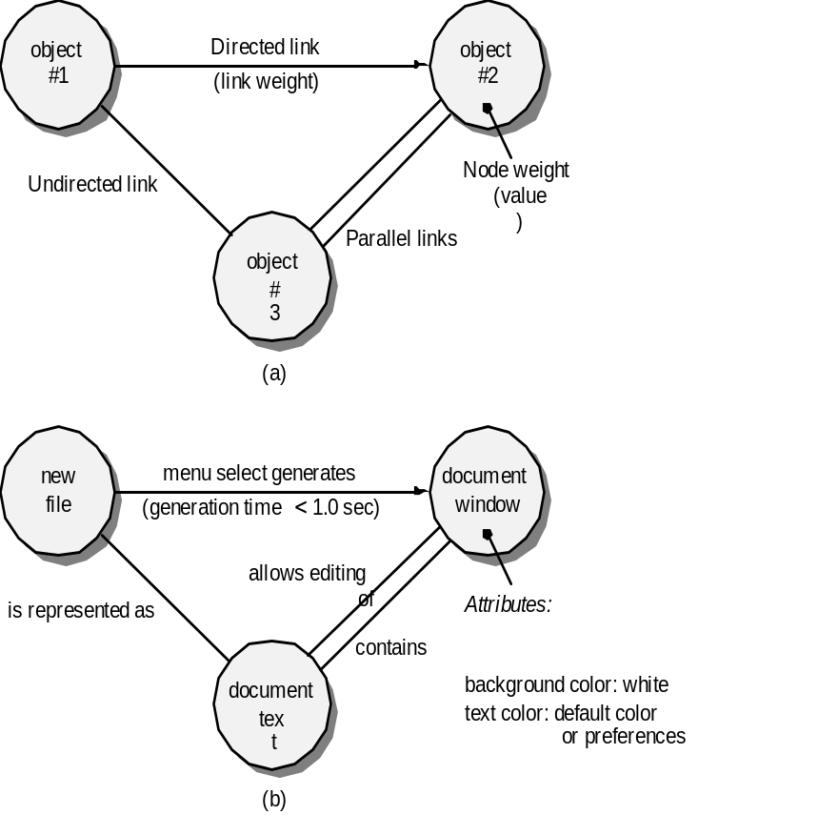
Graph-Based Methods
To understand the objects that are modeled in software and the relationships that connect these objects
In this context, we consider the term “objects” in the broadest possible context. It encompasses data objects, traditional components (modules), and object-oriented elements of computer software.
These slides are designed to accompany Software Engineering: A Practitioner’s Approach, 7/e (McGraw-Hill 2009). Slides copyright 2009 by Roger Pressman.

Slide 33
Equivalence Partitioning
user
queries
output
formats
FK
input
mouse
picks
data
prompts
These slides are designed to accompany Software Engineering: A Practitioner’s Approach, 7/e (McGraw-Hill 2009). Slides copyright 2009 by Roger Pressman.

Slide 34
Sample Equivalence Classes
Valid data
user supplied commands
responses to system prompts
file names
computational data
physical parameters
bounding values
initiation values
output data formatting
responses to error messages
graphical data (e.g., mouse picks)
Invalid data
data outside bounds of the program
physically impossible data
proper value supplied in wrong place
These slides are designed to accompany Software Engineering: A Practitioner’s Approach, 7/e (McGraw-Hill 2009). Slides copyright 2009 by Roger Pressman.

Slide 35
Boundary Value Analysis
user
queries
output
formats
FK
input
mouse
picks
data
prompts
output
domain
input domain
These slides are designed to accompany Software Engineering: A Practitioner’s Approach, 7/e (McGraw-Hill 2009). Slides copyright 2009 by Roger Pressman.

Slide 36
Comparison Testing
Used only in situations in which the reliability of software is absolutely critical (e.g., human-rated systems)
  Separate software engineering teams develop independent versions of an application using the same specification
  Each version can be tested with the same test data to ensure that all provide identical output
  Then all versions are executed in parallel with real-time comparison of results to ensure consistency
These slides are designed to accompany Software Engineering: A Practitioner’s Approach, 7/e (McGraw-Hill 2009). Slides copyright 2009 by Roger Pressman.

Slide 37
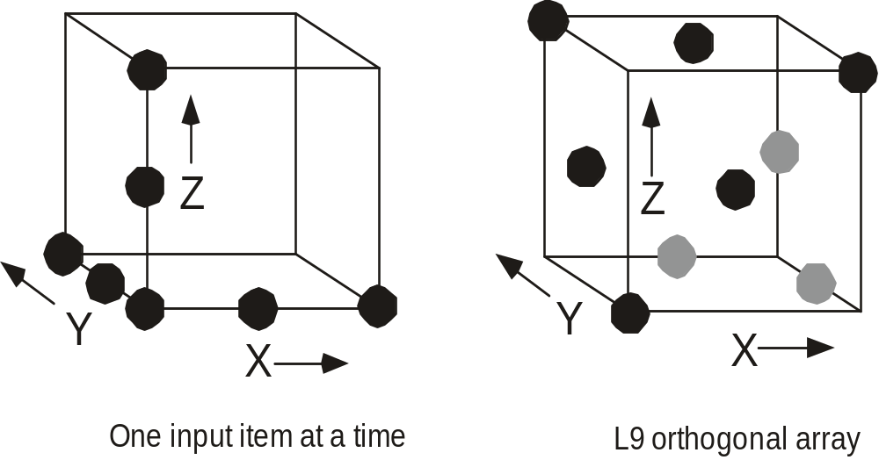
Orthogonal Array Testing
Used when the number of input parameters is small and the values that each of the parameters may take are clearly bounded
These slides are designed to accompany Software Engineering: A Practitioner’s Approach, 7/e (McGraw-Hill 2009). Slides copyright 2009 by Roger Pressman.

Slide 38
Model-Based Testing
Analyze an existing behavioral model for the software or create one.
  Recall that a behavioral model indicates how software will respond to external events or stimuli.
Traverse the behavioral model and specify the inputs that will force the software to make the transition from state to state.
  The inputs will trigger events that will cause the transition to occur.
Review the behavioral model and note the expected outputs as the software makes the transition from state to state.
Execute the test cases.
Compare actual and expected results and take corrective action as required.
These slides are designed to accompany Software Engineering: A Practitioner’s Approach, 7/e (McGraw-Hill 2009). Slides copyright 2009 by Roger Pressman.

Slide 39
Software Testing Patterns
Testing patterns are described in much the same way as design patterns (Chapter 12).
Example:
    Pattern name: ScenarioTesting
    Abstract: Once unit and integration tests have been conducted, there is a need to determine whether the software will perform in a manner that satisfies users. The ScenarioTesting pattern describes a technique for exercising the software from the user’s point of view. A failure at this level indicates that the software has failed to meet a user visible requirement. [Kan01]
These slides are designed to accompany Software Engineering: A Practitioner’s Approach, 7/e (McGraw-Hill 2009). Slides copyright 2009 by Roger Pressman.

